Slide 1




Slide 2

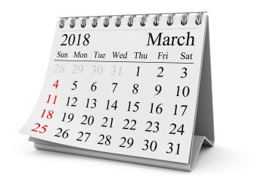
Do you know what this is?

Slide 3

Objective
Identify and write the months of the year

Slide 4

Listen and sing
https://www.youtube.com/watch?v=-d3jkbP1xc8

Slide 5

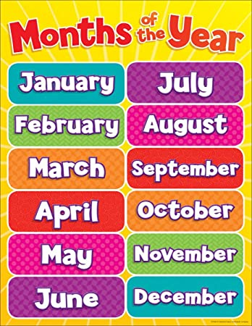
Repeat with me

Slide 6

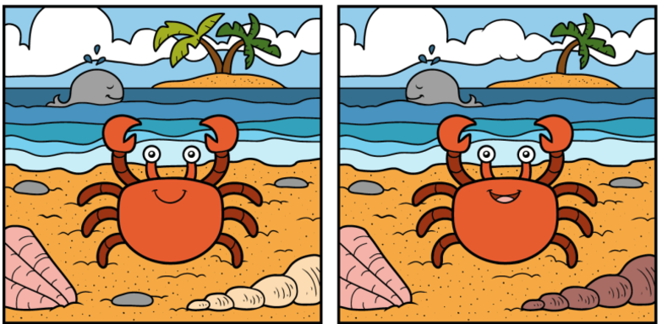
My favorite month
Find the five differences

Slide 7
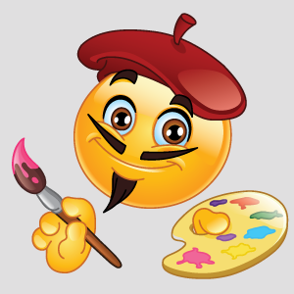
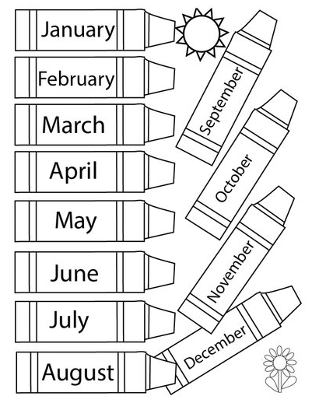
Color your birthday month

Slide 8

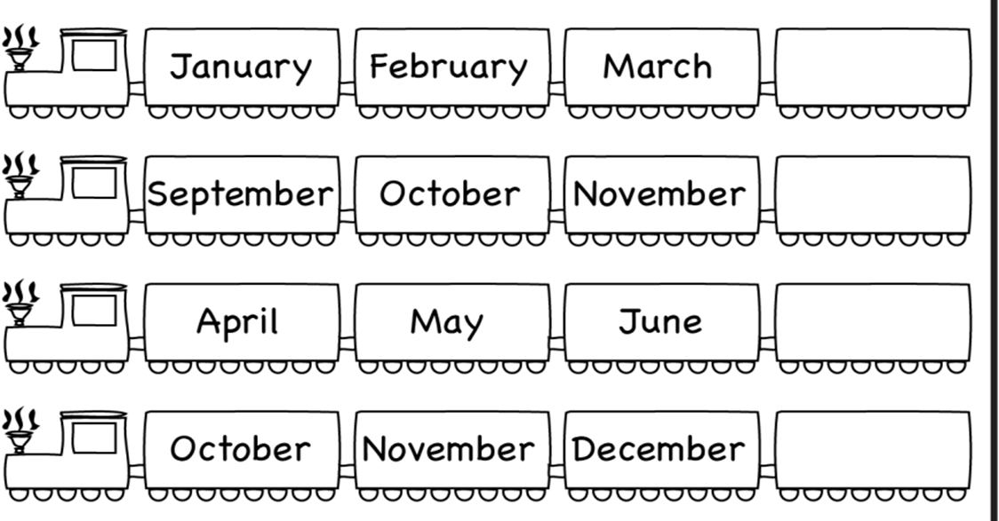
Complete and color the train

Slide 9

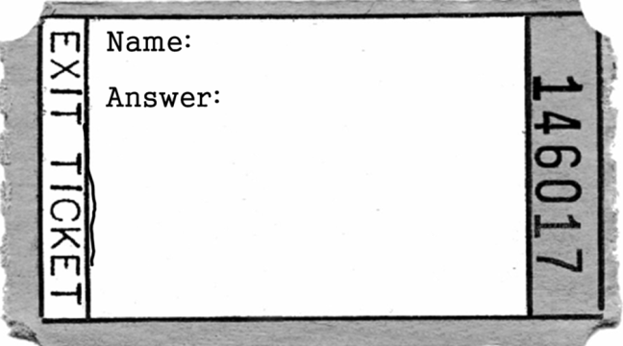
Exit ticket
NAME: GRADE: 3°
How do you write Julio in english? (¿Cómo se escribe julio en inglés?)
Write your favorite month of the year? (escribe tu mes favorito del año)
When Christmas is celebrated? (¿Cuándo se celebra la navidad?)
MISS PÍA CÁCERES G.

Slide 10


